Slide 1
Fundamentals Physics
Tenth Edition
Halliday
Chapter 4
Motion in Two and Three Dimensions

Slide 2
4-1 Position and Displacement (1 of 4)
Learning Objectives
4.01 Draw two-dimensional and three-dimensional position vectors for a particle, indicating the components along the axes of a coordinate system.
4.02 On a coordinate system, determine the direction and magnitude of a particle's position vector from its components, and vice versa.
4.03 Apply the relationship between a particle’s displacement vector and its initial and final position vectors.

Slide 3
4-1 Position and Displacement (2 of 4)
A position vector locates a particle in space
Extends from a reference point (origin) to the particle
Equation (4-1)
Example
Position vector (−3m, 2m, 5m)

Slide 4
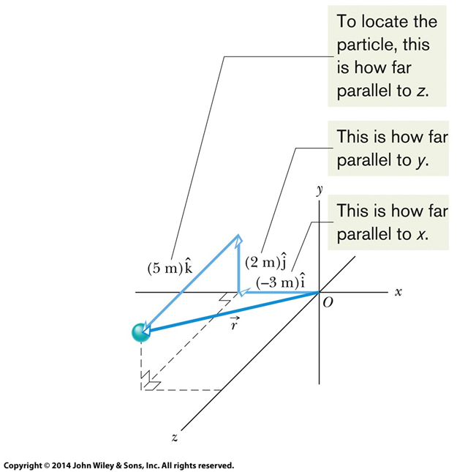
4-1 Position and Displacement (3 of 4)
Figure 4-1

Slide 5
4-1 Position and Displacement (4 of 4)
Change in position vector is a displacement
Equation (4-2)
We can rewrite this as:
Equation (4-3)
Or express it in terms of changes in each coordinate:
Equation (4-4)

Slide 6
4-2 Average Velocity and Instantaneous Velocity (1 of 9)
Learning Objectives
4.04 Identify that velocity is a vector quantity and thus has both magnitude and direction and also has components.
4.05 Draw two-dimensional and three-dimensional velocity vectors for a particle, indicating the components along the axes of the coordinate system.
4.06 In magnitude-angle and unit-vector notations, relate a particle’s initial and final position vectors, the time interval between those positions, and the particle’s average velocity vector.
4.07 Given a particle’s position vector as a function of time, determine its (instantaneous) velocity vector.

Slide 7
4-2 Average Velocity and Instantaneous Velocity (2 of 9)
Average velocity is
A displacement divided by its time interval
Equation (4-8)
We can write this in component form:
Equation (4-9)

Slide 8
4-2 Average Velocity and Instantaneous Velocity (3 of 9)
Example
A particle moves through displacement (12 m)i + (3.0 m)k in 2.0 s:

Slide 9
4-2 Average Velocity and Instantaneous Velocity (4 of 9)
Instantaneous velocity is
The velocity of a particle at a single point in time
The limit of avg. velocity as the time interval shrinks to 0
Equation (4-10)

Slide 10
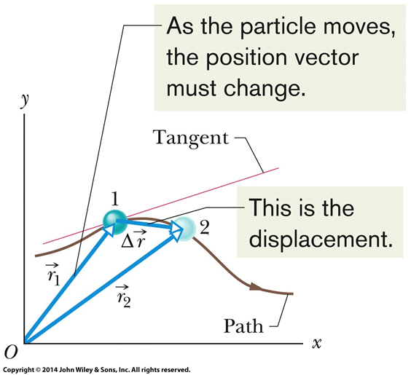
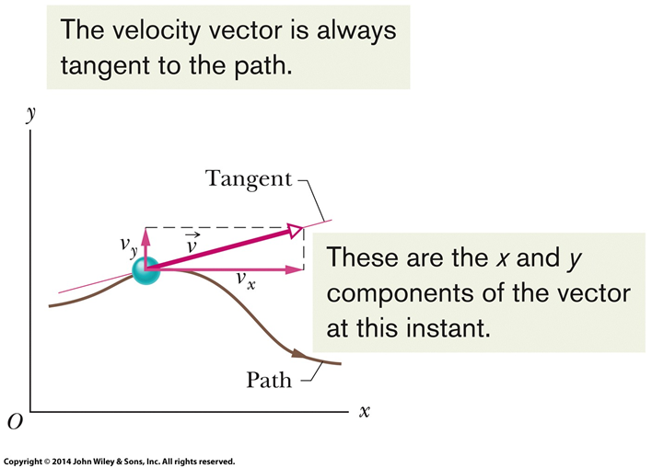
4-2 Average Velocity and Instantaneous Velocity (5 of 9)
Visualize displacement and instantaneous velocity:
Figure 4-3
Figure 4-4

Slide 11
4-2 Average Velocity and Instantaneous Velocity (6 of 9)
The direction of the instantaneous velocity
of a particle is
always tangent to the particle’s path at the particle’s position.
In unit-vector form, we write:
Which can also be written:
Equation (4-11)

Slide 12
4-2 Average Velocity and Instantaneous Velocity (7 of 9)
Equation (4-12)
Note: a velocity vector does not extend from one point to another, only shows direction and magnitude

Slide 13
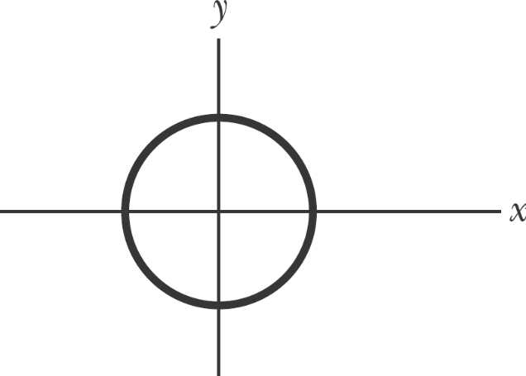
4-2 Average Velocity and Instantaneous Velocity (8 of 9)
Checkpoint 1
The figure shows a circular path taken by a particle. If the
instantaneous velocity of the particle is
through which quadrant is the particle moving at that instant if it is traveling (a) clockwise and (b) counterclockwise around the circle?
For both cases, draw
on the figure.

Slide 14
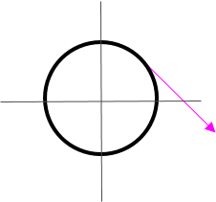
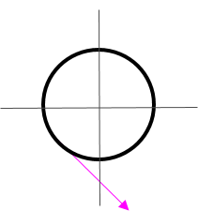
4-2 Average Velocity and Instantaneous Velocity (9 of 9)
Answer:
(a) Quadrant I
(b) Quadrant III

Slide 15
4-3 Average Acceleration and Instantaneous Acceleration (1 to 8)
Learning Objectives
4.08 Identify that acceleration is a vector quantity, and thus has both magnitude and direction.
4.09 Draw two-dimensional and three-dimensional acceleration vectors for a particle, indicating the components.
4.10 Given the initial and final velocity vectors of a particle and the time interval, determine the average acceleration vector.
4.11 Given a particle's velocity vector as a function of time, determine its (instantaneous) acceleration vector.
4.12 For each dimension of motion, apply the constant-acceleration equations (Chapter 2) to relate acceleration, velocity, position, and time.

Slide 16
4-3 Average Acceleration and Instantaneous Acceleration (2 to 8)
Average acceleration is
A change in velocity divided by its time interval
Equation (4-15)
Instantaneous acceleration is again the limit t → 0:
Equation (4-16)

Slide 17
4-3 Average Acceleration and Instantaneous Acceleration (3 to 8)
We can write Eq. 4-16 in unit-vector form:

Slide 18
4-3 Average Acceleration and Instantaneous Acceleration (4 to 8)
We can rewrite as:
Equation (4-17)
Equation (4-18)
To get the components of acceleration, we differentiate the components of velocity with respect to time

Slide 19
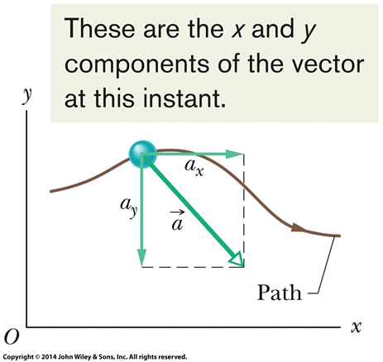
4-3 Average Acceleration and Instantaneous Acceleration (5 to 8)
Figure 4-6

Slide 20
4-3 Average Acceleration and Instantaneous Acceleration (6 to 8)
Note: as with velocity, an acceleration vector does not extend from one point to another, only shows direction and magnitude

Slide 21
4-3 Average Acceleration and Instantaneous Acceleration (7 to 8)
Checkpoint 2
Here are four descriptions of the position (in meters) of a puck as it moves in an xy plane:
​
​
​
​
Are the x and y acceleration components constant? Is acceleration
constant?

Slide 22
4-3 Average Acceleration and Instantaneous Acceleration (8 to 8)
Answer:
​​x : yes, y : yes, a : yes
​​x : no, y : yes, a : no
​​x : yes, y : yes, a : yes
​x : no, y : yes, a : no

Slide 23
4-4 Projectile Motion (1 of 11)
Learning Objectives
4.13 On a sketch of the path taken in projectile motion, explain the magnitudes and directions of the velocity and acceleration components during the flight.
4.14 Given the launch velocity in either magnitude-angle or unit-vector notation, calculate the particle's position, displacement, and velocity at a given instant during the flight.
4.15 Given data for an instant during the flight, calculate the launch velocity.

Slide 24
4-4 Projectile Motion (2 of 11)
A projectile is
A particle moving in the vertical plane
With some initial velocity
Whose acceleration is always free-fall acceleration (g)
The motion of a projectile is projectile motion
Launched with an initial velocity v₀
Equation (4-19)
Equation (4-20)
In projectile motion, the horizontal motion and the vertical motion are independent of each other; that is, neither motion affects the other.

Slide 25
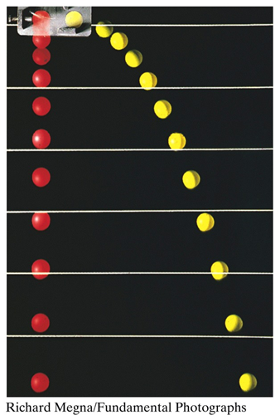
4-4 Projectile Motion (3 of 11)
Therefore we can decompose two-dimensional motion into 2 one-dimensional problems
Figure 4-10

Slide 26
4-4 Projectile Motion (4 of 11)
Checkpoint 3
At a certain instant, a fly ball has velocity
(the x axis is horizontal, the y axis is upward, and
is in meters per second). Has the ball passed its highest point?
Answer:
Yes. The y-velocity is negative, so the ball is now falling.

Slide 27
4-4 Projectile Motion (5 of 11)
Horizontal motion:
No acceleration, so velocity is constant (recall Eq. 2-15):
Equation (4-21)

Slide 28
4-4 Projectile Motion (6 of 11)
Vertical motion:
Acceleration is always -g (recall Eqs. 2-15, 2-11, 2-16):
Equation (4-22)
Equation (4-23)
Equation (4-24)

Slide 29
4-4 Projectile Motion (7 of 11)
The projectile’s trajectory is
Its path through space (traces a parabola)
Found by eliminating time between Eqs. 4-21 and 4-22:
Equation (4-25)

Slide 30
4-4 Projectile Motion (8 of 11)
The horizontal range is:
The distance the projectile travels in x by the time it returns to its initial height
Equation (4-26)
The horizontal range R is maximum for a launch angle of 45°.

Slide 31
4-4 Projectile Motion (9 of 11)
In these calculations we assume air resistance is negligible
In many situations this is a poor assumption:
Table 4-1 Two Fly Balls ª
 | Path I (Air) | Path II (Vacuum)
Range | 98.5 m | 177 m
Maximum height | 53.0 m | 76.8 m
Time of flight | 6.6 s | 7.9 s
ª See Fig. 4-13. The launch angle is 60° and the launch speed is 44.7 m/s.
Copyright © 2018 John Wiley & Sons, Inc. All rights reserved.
Table 4-1

Slide 32
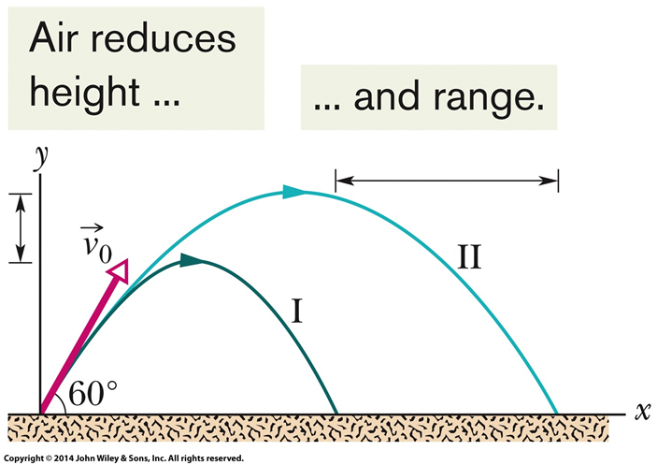
4-4 Projectile Motion (10 of 11)
Figure 4-13

Slide 33
4-4 Projectile Motion (11 of 11)
Checkpoint 4
A fly ball is hit to the outfield. During its flight (ignore the effects of the air), what happens to its (a) horizontal and (b) vertical components of velocity? What are the (c) horizontal and (d) vertical components of its acceleration during ascent, during descent, and at the topmost point of its flight?
Answer:
(a) is unchanged
(b) decreases (becomes negative)
(c) 0 at all times
(d)

Slide 34
4-5 Uniform Circular Motion (1 of 4)
Learning Objectives
4.16 Sketch the path taken in uniform circular motion and explain the velocity and acceleration vectors (magnitude and direction) during the motion.
4.17 Apply the relationships between the radius of the circular path, the period, the particle's speed, and the particle’s acceleration magnitude.

Slide 35
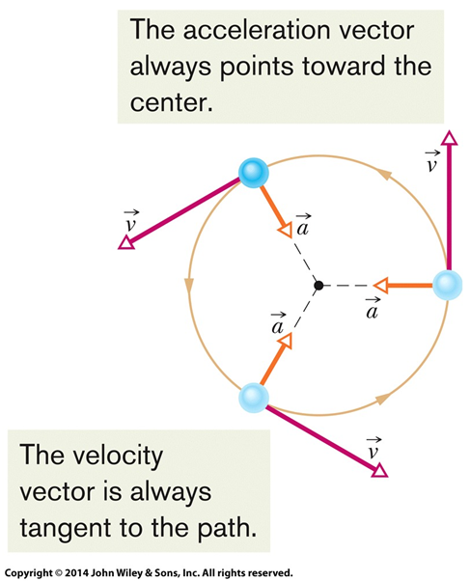
4-5 Uniform Circular Motion (2 of 4)
A particle is in uniform circular motion if
It travels around a circle or circular arc
At a constant speed
Since the velocity changes, the particle is accelerating!
Velocity and acceleration have:
Constant magnitude
Changing direction
Figure 4-16

Slide 36
4-5 Uniform Circular Motion (3 of 4)
Acceleration is called centripetal acceleration
Means “center seeking”
Directed radially inward
Equation (4-34)
The period of revolution is:
The time it takes for the particle go around the closed path exactly once
Equation (4-35)

Slide 37
4-5 Uniform Circular Motion (4 of 4)
Checkpoint 5
An object moves at constant speed along a circular path in a horizontal xy plane, with the center at the origin. When the
object is at x = −2 m, its velocity is
Give the object’s (a) velocity and (b) acceleration at y = 2 m.
Answer:
(a)
(b)

Slide 38
4-6 Relative Motion in One Dimension (1 of 6)
Learning Objectives
4.18 Apply the relationship between a particle's position, velocity, and acceleration as measured from two reference frames that move relative to each other at a constant velocity and along a single axis.

Slide 39
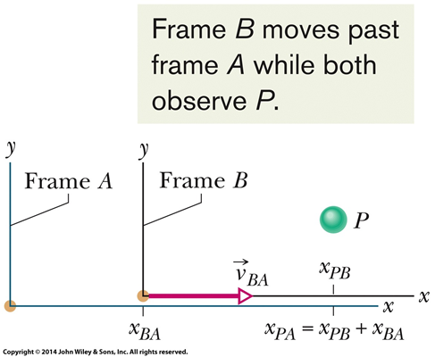
4-6 Relative Motion in One Dimension (2 of 6)
Measures of position and velocity depend on the reference frame of the measurer
How is the observer moving?
Our usual reference frame is that of the ground
Read subscripts “PA”, “PB”, and “BA” as “P as measured by A”, “P as measured by B”, and “B as measured by A"
Frames A and B are each watching the movement of object P
Figure 4-18

Slide 40
4-6 Relative Motion in One Dimension (3 of 6)
Positions in different frames are related by:
Equation (4-40)
Taking the derivative, we see velocities are related by:
Equation (4-41)

Slide 41
4-6 Relative Motion in One Dimension (4 of 6)
But accelerations (for non-accelerating reference frames, a_{BA} = 0) are related by
Equation (4-42)

Slide 42
4-6 Relative Motion in One Dimension (5 of 6)
Observers on different frames of reference that move at constant velocity relative to each other will measure the same acceleration for a moving particle.
Example
Frame A: x = 2 m, v = 4 m/s Frame B: x = 3 m, v = −2 m/s
P as measured by A: x_{PA} = 5 m, v_{PA} = 2 m/s,

Slide 43
4-6 Relative Motion in One Dimension (6 of 6)
So P as measured by B:
x_{PB} = x_{PA} + x_{AB} = 5 m + (2m – 3m) = 4 m
v_{PB} = v_{PA} + v_{AB} = 2 m/s + (4 m/s – −2m/s) = 8 m/s

Slide 44
4-7 Relative Motion in Two Dimensions (1 of 3)
Learning Objectives
4.19 Apply the relationship between a particle's position, velocity, and acceleration as measured from two reference frames that move relative to each other at a constant velocity and in two dimensions.

Slide 45
4-7 Relative Motion in Two Dimensions (2 of 3)
The same as in one dimension, but now with vectors:
Positions in different frames are related by:
Equation (4-43)
Velocities:
Equation (4-44)
Accelerations (for non-accelerating reference frames):
Equation (4-45)
Again, observers in different frames will see the same acceleration

Slide 46
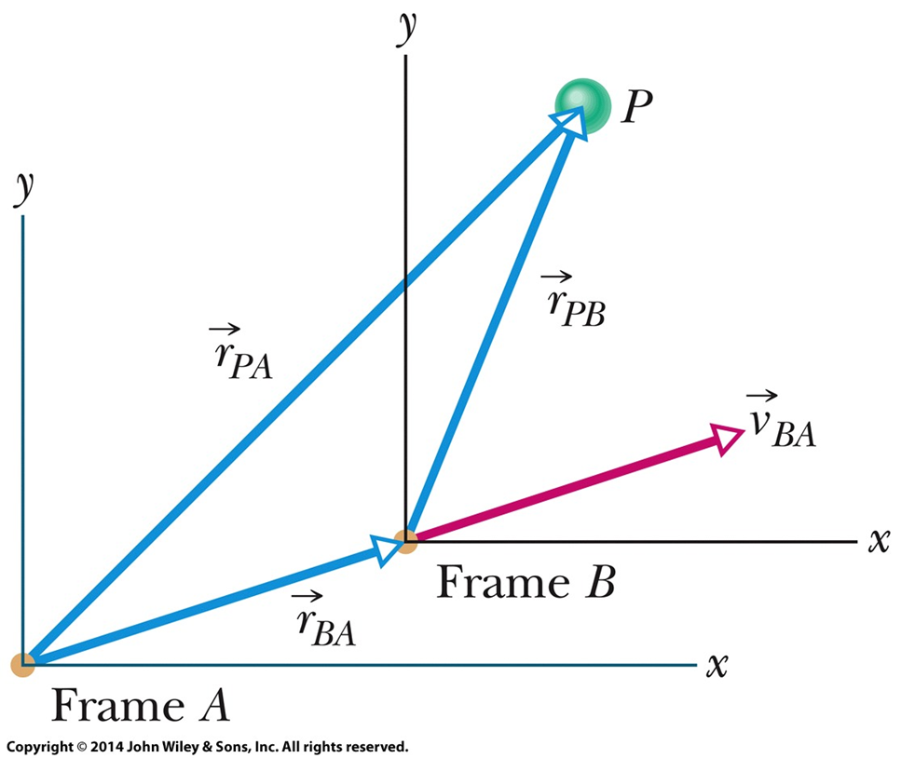
4-7 Relative Motion in Two Dimensions (3 of 3)
Frames A and B are both observing the motion of P
Figure 4-19

Slide 47
4 Summary (1 of 6)
Position Vector
Locates a particle in 3-space
Equation (4-1)
Displacement
Change in position vector
Equation (4-2)
Equation (4-3)
Equation (4-4)

Slide 48
4 Summary (2 of 6)
Average and Instantaneous Velocity
Equation (4-8)
Equation (4-10)
Average and Instantaneous Accel.
Equation (4-15)
Equation (4-16)

Slide 49
4 Summary (3 of 6)
Projectile Motion
Flight of particle subject only to free-fall acceleration (g)
Equation (4-22)
Equation (4-23)
Trajectory is parabolic path
Equation (4-25)

Slide 50
4 Summary (4 of 6)
Horizontal range:
Equation (4-26)

Slide 51
4 Summary (5 of 6)
Uniform Circular Motion
Magnitude of acceleration:
Equation (4-34)
Time to complete a circle:
Equation (4-35)

Slide 52
4 Summary (6 of 6)
Relative Motion
For non-accelerating reference frames
Equation (4-44)
Equation (4-45)

Slide 53
Copyright
Copyright © 2018 John Wiley & Sons, Inc.
All rights reserved. Reproduction or translation of this work beyond that permitted in Section 117 of the 1976 United States Act without the express written permission of the copyright owner is unlawful. Request for further information should be addressed to the Permissions Department, John Wiley & Sons, Inc. The purchaser may make back-up copies for his/her own use only and not for distribution or resale. The Publisher assumes no responsibility for errors, omissions, or damages, caused by the use of these programs or from the use of the information contained herein.

